Slide 1
Hurtownie Danych
SSIS Zawansowany cz.2

Slide 2
File System Task

Slide 3
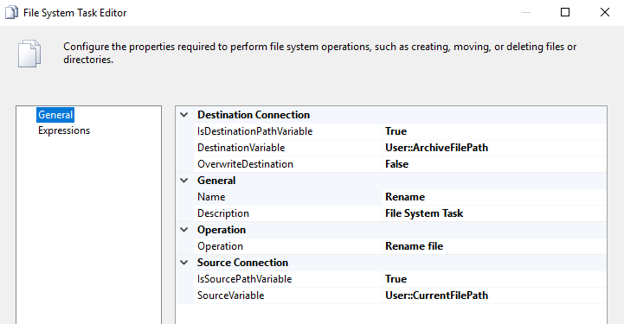
File System Task
The File System task performs operations on files and directories in the file system. For example, by using the File System task, a package can create, move, or delete directories and files. You can also use the File System task to set attributes on files and directories. For example, the File System task can make files hidden or read-only.

Slide 4
File System Task
The File System task includes a predefined set of operations. The following table describes these operations.
Copy directory Copies a folder from one location to another.
Copy file Copies a file from one location to another.
Create directory Creates a folder in a specified location.
Delete directory Deletes a folder in a specified location.
Delete directory content Deletes all files and folders in a folder.
Delete file Deletes a file in a specified location.
Move directory Moves a folder from one location to another.
Move file Moves a file from one location to another.
Rename file Renames a file in a specified location.
Set attributes Sets attributes on files and folders. Attributes include Archive, Hidden, Normal, ReadOnly, and System. Normal is the lack of attributes, and it cannot be combined with other attributes. All other attributes can be used in combination.

Slide 5
Expressions

Slide 6
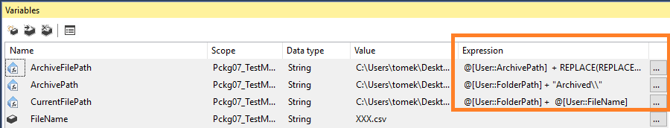
SSIS Expressions
Cheat-sheet:
https://pragmaticworks.com/ResourcesDup/Cheat-Sheets/SSIS-Expression-Cheat-Sheet
MSDN examples:
https://docs.microsoft.com/en-us/sql/integration-services/expressions/examples-of-advanced-integration-services-expressions

Slide 7
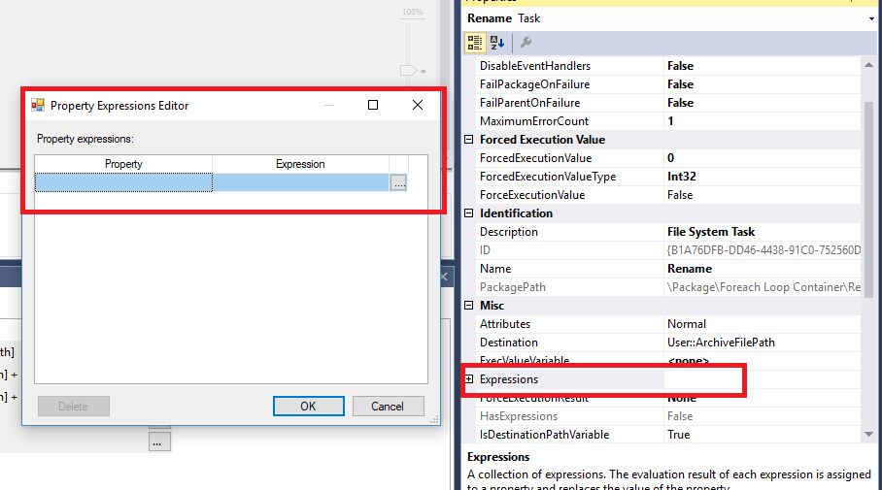
SSIS Expressions

